Slide 1

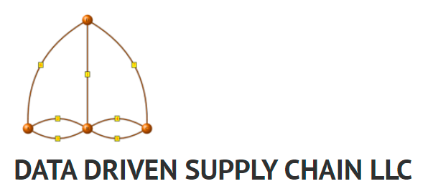

Introduction to Monte Carlo Simulation Using Shiny
Ralph Asher, Founder
ralph@datadrivensupplychain.com
datadrivensupplychain.com
https://github.com/datadrivensupplychain

Slide 2






Who Am I? Where am I? Why am I?
BS Physics, Valparaiso University (Indiana) 2006
MS Operations Research, Florida Inst. Tech. 2012
US Marine Corps, 2006-2012 (Active Duty), 2013-Present (Reservist)
General Mills: Supply Chain Analytics Consultant, 2013-2015
Target: Supply Chain Operations Research Scientist, 2015-2021
E-Commerce Network Design, modeling the future of Target E-commerce Supply Chain
Data Driven Supply Chain LLC: Founder June 2021!
Artificial Intelligence + Supply Chain, For Your Organization
Consulting & Corporate Training in Supply Chain Analytics & AI
www.datadrivensupplychain.com
R user since 2012
Math and map enthusiast since ~1990

Slide 3
Agenda
How can we use data, math, and advanced analytical methods to understand risk and uncertainty?
Introduction to “the flaw of averages” and thinking in terms of ranges, not single values
Conceptual Introduction to Monte Carlo Simulation
Using Shiny for interactive Monte Carlo Simulation
Open Discussion

Slide 4
“The Flaw of Averages”
Inputs to key decisions (for example, sales forecasts, cost inputs) are not a single point value, but a range (distribution)
Making decisions based on the average of those values, ignores potential impacts of those inputs coming in higher or lower than average
If you can’t swim… don’t try to cross a creek based upon its “average” depth
Popularized by Dr. Sam Savage in 2002 Harvard Business Review article, and subsequent book
https://hbr.org/2002/11/the-flaw-of-averages
Notes:
https://hbr.org/2002/11/the-flaw-of-averages
Probabilitymanagement.org

Slide 5
Monte Carlo Simulation
Analytical method that evaluates a lot of potential combinations of uncertain inputs – drawing from their range of possibilities – and calculates the overall outcome
If K = f(x,y,z), and x, y, and z are not single point values but distributions, what is the distribution of K? What are the real-world impacts of different segments of K’s distribution?
“It shows the extreme possibilities along with all possible consequences for middle-of-the-road decisions.”
Finance (stress testing, mergers & acquisitions), Oil & Gas (investment decisions on drilling oil wells), Supply Chain (impact of variable demand, upon different facilities in the supply chain)
Notes:
Quote from Palisade https://www.palisade.com/risk/monte_carlo_simulation.asp

Slide 6
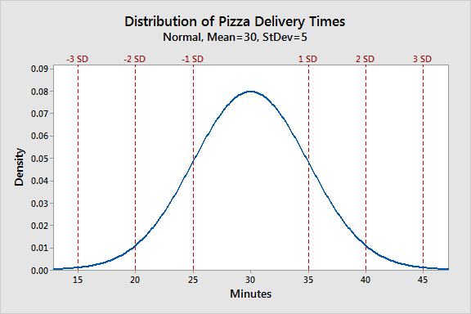
Normal Distribution (Bell curve)
Described by two values, mean (mu) and standard deviation (sigma): N(mean,SD)
Mean (average) = median (middle value)
Symmetric around the mean: -1 SD values are equally likely as +1 SD values
Standard deviation describes the likelihood of a range of outcomes:
68% of values are within +/- 1 standard deviation
95.5% of values within +/- 2 SD
99.7% of values within +/- 3 SD
“Tail Risk” are those unlikely, but impactful outcomes… a pizza that comes in 15 minutes (-3 SD) or 45 minutes (+3 SD)
In this talk’s example, all the inputs will be normally distributed
Notes:
Thanks to whoever’s website was scraped by Google Images.

Slide 7
Monte Carlo Simulation – Ralph & Bob go to dinner
Ralph and his next-door neighbor Bob both work in downtown Minneapolis, and take the same bus route, from the same bus stops, to and from work
We have reservations to go to dinner at 6:15pm on a weeknight at a popular restaurant in our neighborhood. We’ll leave the office at 5:30pm.
Will we make it in time?
https://datadrivensupplychain.shinyapps.io/restaurant_sim_app/

Slide 8


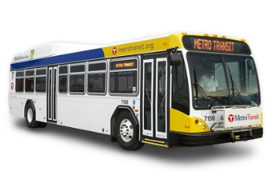


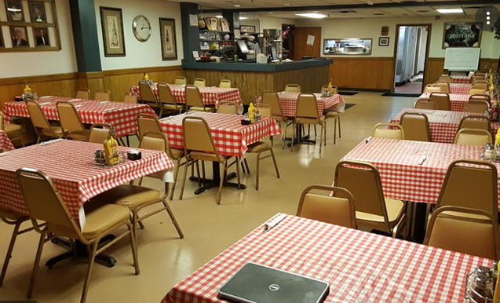



Time Elapsed Between Leaving Office and Arriving At Home: N(30,10)
Time Walking From Home to Restaurant: N(10,2), Depart After Later Arrival
Leave 5:30pm
We May Not Take the Same Bus
Time Elapsed Between Leaving Office and Arriving At Home: N(30,10)
Leave 5:30pm
Expected Arrival Time, Based Upon Averages: 5:30pm + 30mins commute + 10mins walk = 6:10pm. 5 minutes early for our 6:15pm reservation!
https://datadrivensupplychain.shinyapps.io/restaurant_sim_app/
Notes:
Voiceover: our two main components: the time from our respective offices downtown, to our respective homes, and our walk time to the restaurant, are distributions, NOT point estimates. So we don’t know FOR SURE if we’ll make it. MC Simulation makes it a flash.

Slide 9
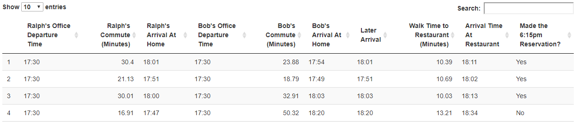
Monte Carlo Simulation – Ralph & Bob go to dinner
First simulation: I get home at 6:01pm, Bob got home at 5:54pm. When I got home at 6:01pm, we took about 10 minutes to walk to the restaurant… arrived 6:11pm. Right on average!
Second simulation: we both have a really short commute, get there 13 minutes early!
Third simulation: Bob’s commute was a little longer than average, but we got there two minutes early….
Fourth simulation: Bob’s commute was horrid. We missed our table.
https://datadrivensupplychain.shinyapps.io/restaurant_sim_app/
Notes:
So what happened in the fourth simulation ? Even though my commute was really short, Bob’s wasn’t, and our average commute was 34 minutes between us… we didn’t get there in time. How often does that happen?

Slide 10
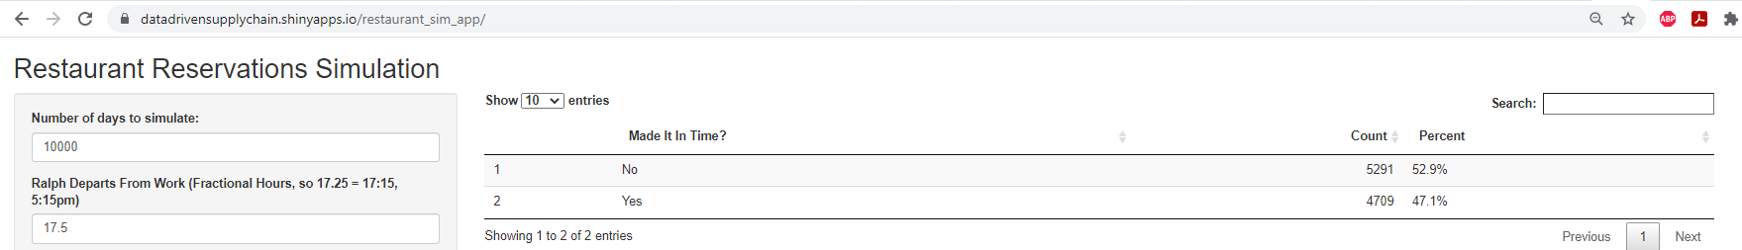
Rinse and Repeat 10,000 Times…
We missed our reservation more than half the time, by planning based upon the average
https://datadrivensupplychain.shinyapps.io/restaurant_sim_app/
Notes:
Questions to group… why did we miss it over half the time?
Whoever is later to get home, Ralph or Bob, is the primary factor for whether we end up early, on time, or late.
Is showing up 40 minutes late bad? Is showing up 40 minutes early good?

Slide 11
Rinse and Repeat 10,000 Times…
Introduction to the App
What are the things we can do to make it more likely that we’ll arrive on time?
What is the magnitude of the impact of being 5mins early vs 5mins late? What about 10mins early vs 10mins late?
https://datadrivensupplychain.shinyapps.io/restaurant_sim_app/
Notes:
Discussion: Under what circumstances is it better to be early? Under what circumstances is it better to be late? What is the magnitude of the impact of being 5mins early vs 5mins late? What about 10mins early vs 10mins late?

Slide 12
Rinse and Repeat 10,000 Times…
What is unrealistic about this simulation?
Problem Definition, Talking Through Details Are Key…

Slide 13
Takeaways
Monte Carlo simulation – incredibly helpful tool for evaluating potential outcomes of uncertain inputs
Any platform: R, Python, Excel (if absolutely necessary)
Spurs important discussions on a range of outcomes and the impact on decisions

Slide 14


Thank you!
Ralph Asher
Founder, Data Driven Supply Chain LLC
ralph@datadrivensupplychain.com
datadrivensupplychain.com
https://github.com/datadrivensupplychain
https://www.linkedin.com/in/ralphasher/

Slide 15
Appendix

Slide 16
How can we use data to understand risk and uncertainty?
Most people are inherently paralyzed by uncertainty and tend to ignore it in our lives.
Will my home burn down today?
Will I get sick?
Will the Chipotle line be too long, to make it back to work on time?
Our typical decisions are based either upon heuristics (good rules of thumb), or a single estimate
Will I make it to the airport in time?
How much can I afford on a mortgage?
Our ability to objectively evaluate decisions, declines with complexity and uncertainty about the important details
Should I go to college?
Should I take that job?
Should I marry this person?
Enabling decision-making under uncertainty, absent of emotion, is a major triumph of operations research
Thinking, Fast and Slow
Fooled By Randomness
Farnam Street (website)

